Slide 1
Lecture 05: Lexical Analysis Tokens
CS351 Lecture 05 - LA - Tokens

Slide 2
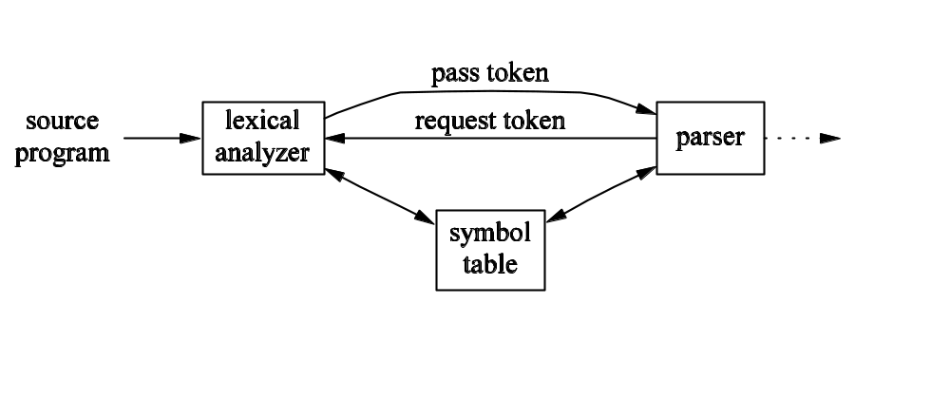
Lexical Analyzer and Parser
CS351 Lecture 05 - LA - Tokens

Slide 3
Why Separate?
Reasons to separate lexical analysis from parsing:
  Simpler design
  Improved efficiency
  Portability
Tools exist to help implement lexical analyzers and parsers independently
CS351 Lecture 05 - LA - Tokens

Slide 4
Tokens, Lexemes, and Patterns
Tokens include keywords, operators, identifiers, constants, literal strings, punctuation symbols
A lexeme is a sequence of characters in the source program representing a token
A pattern is a rule describing a set of lexemes that can represent a particular token
CS351 Lecture 05 - LA - Tokens

Slide 5
Attributes
Attributes provide additional information about tokens
Technically speaking, lexical analyzers usually provide a single attribute per token (might be pointer into symbol table)
CS351 Lecture 05 - LA - Tokens

Slide 6
Buffer
Most lexical analyzers use a buffer
Often buffers are divided into two N character halves
Two pointers used to indicate start and end of lexeme
If pointer walks past end of either half of buffer, other half of buffer is reloaded
A sentinel character can be used to decrease number of checks necessary
CS351 Lecture 05 - LA - Tokens

Slide 7
Strings and Languages
Alphabet – any finite set of symbols (e.g. ASCII, binary alphabet, or a set of tokens)
String – A finite sequence of symbols drawn from an alphabet
Language – A set of strings over a fixed alphabet
Other terms relating to strings: prefix; suffix; substring; proper prefix, suffix, or substring (non-empty, not entire string); subsequence
CS351 Lecture 05 - LA - Tokens

Slide 8


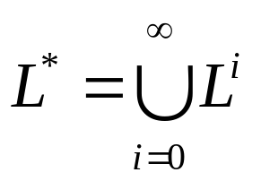
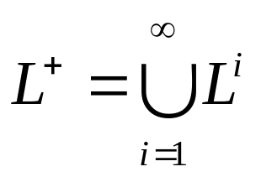
Operations on Languages
Union:
Concatenation:
Kleene closure:
  Zero or more concatenations
Positive closure:
  One or more concatenations
CS351 Lecture 05 - LA - Tokens

Slide 9
Regular Expressions
Defined over an alphabet Σ
ε represents {ε}, the set containing the empty string
If a is a symbol in Σ, then a is a regular expression denoting {a}, the set containing the string a
If r and s are regular expressions denoting the languages L(r) and L(s), then:
  (r)|(s) is a regular expression denoting L(r)U L(s)
  (r)(s) is a regular expression denoting L(r)L(s)
  (r)* is a regular expression denoting (L(r))*
  (r) is a regular expression denoting L(r)
Precedence: * (left associative), then concatenation (left associative), then | (left associative)
CS351 Lecture 05 - LA - Tokens

Slide 10
Regular Definitions
Can give “names” to regular expressions
Convention: names in boldface (to distinguish them from symbols)
letter → A|B|…|Z|a|b|…|z
digit → 0|1|…|9
id → letter (letter | digit)*
CS351 Lecture 05 - LA - Tokens

Slide 11
Notational Shorthands
One or more instances: r⁺ denotes rr*
Zero or one Instance: r? denotes r|ε
Character classes: [a-z] denotes [a|b|…|z]
digit → [0-9]
digits → digit⁺
optional_fraction → (. digits )?
optional_exponent → (E(+|-)? digits )?
num → digits optional_fraction optional_exponent
CS351 Lecture 05 - LA - Tokens

Slide 12
Limitations
Can not describe balanced or nested constructs
  Example, all valid strings of balanced parentheses
  This can be done with CFG
Can not describe repeated strings
  Example: {wcw|w is a string of a’s and b’s}
  Can not denote with CFG either!
CS351 Lecture 05 - LA - Tokens

Slide 13
Grammar Fragment (Pascal)
stmt → if expr then stmt
| if expr then stmt else stmt
| ε
expr → term relop term
| term
term → id | num
CS351 Lecture 05 - LA - Tokens

Slide 14
Related Regular Definitions
if → if
then → then
else → else
relop → < | <= | = | <> | > | >=
id → letter ( letter | digit )*
num → digit⁺ (. digit⁺ )? (E(+|-)? digit⁺ )?
delim → blank | tab | newline
ws → delim⁺
CS351 Lecture 05 - LA - Tokens

Slide 15
Tokens and Attributes
Regular Expression | Token | Attribute Value
ws | - | -
if | if | -
then | then | -
else | else | -
id | id | pointer to entry
num | num | pointer to entry
< | relop | LT
<= | relop | LE
= | relop | EQ
<> | relop | NE
> | relop | GT
=> | relop | GE
CS351 Lecture 05 - LA - Tokens

Slide 16

Exercise
CS351 Lecture 05 - LA - Tokens

